Slide 1
OrientDB
Course: Introduction of Big Data
Team code: KHMT1-06

Slide 2
Team member
Student ID | Name
21127456 | Võ Cao Trí
21127608 | Trần Trung Hiếu
21127668 | Đinh Quang Phong

Slide 3
TABLE OF CONTENTS
01
02
03
04
05
06
Introduction
Major components
Application
Demo
Comparison
Conclusion

Slide 4
1.
Introduction

Slide 5
Evolution
Origins and Authorship
Storage engine evolution
Multi-model engine
Community

Slide 6
Solved problem by using OrientDB
Scalability
Schema Flexibility
Performance
Complex Data Relationships
Integration Challenges

Slide 7
2.
Major components

Slide 8
2. Major components
Hybrid Transactions
Distributed architecture
NoSQL multi-model
Cluster Indexes
Polyglot Queries

Slide 9
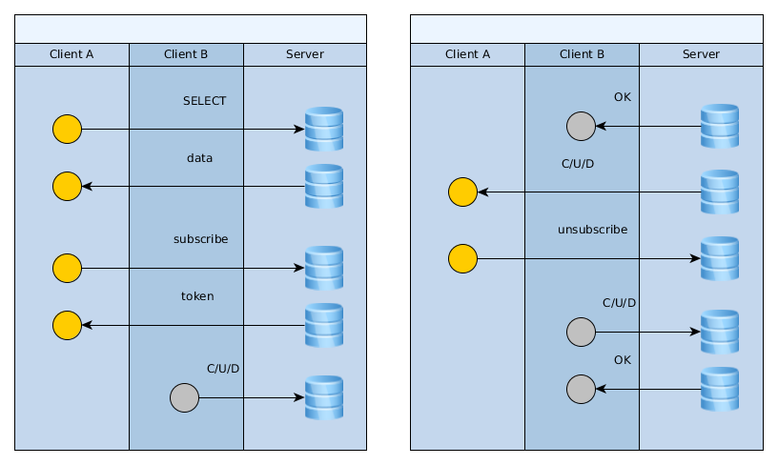
2. 1. Hybrid Transactions
OrientDB's Approach: OrientDB focuses on ACID transactions (Atomicity, Consistency, Isolation, Durability) for data integrity. It allows you to perform mixed operations (record updates, graph traversals) within a single transaction, leveraging its polyglot query capabilities (SQL++, Gremlin, etc.) to interact with different data structures.

Slide 10
2. 2. Distributed architecture
OrientDB can be distributed across different servers and used in different ways to achieve the maximum of performance, scalability and robustness.
OrientDB uses the Hazelcast Open Source project for auto-discovering of nodes, storing the runtime cluster configuration and synchronizing certain operations between nodes.
OrientDB supports the Multi Master replication. This means that all the nodes in the cluster are Master and are able to read and write to the database.

Slide 11
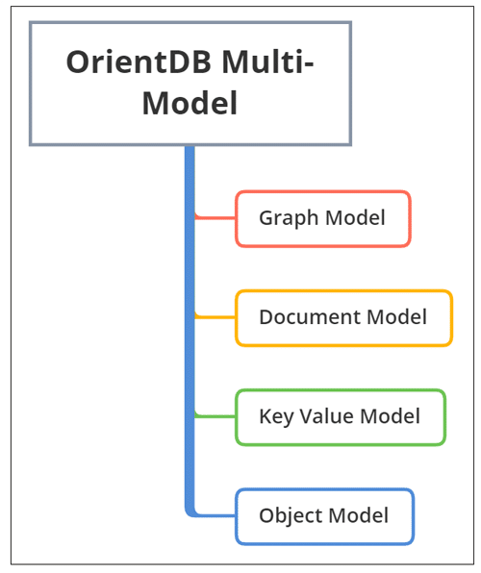
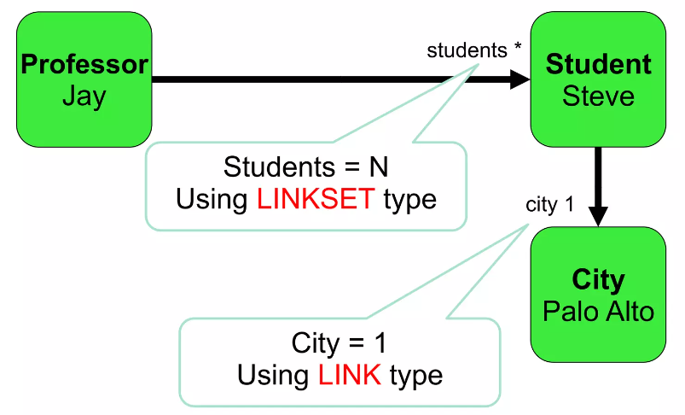
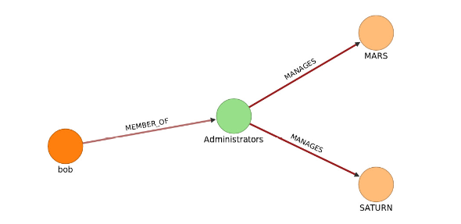
2. 3. NoSQL multi-model
OrientDB is a NoSQL database known for its unique multi-model capabilities. This means it can handle data in various formats and structures within a single database, offering flexibility and adaptability for different use cases.
Graph Model
Document Model
Object Model

Slide 12
2. 4. Cluster Indexes
OrientDB can use two methods to update indexes:
Automatic Where the index is bound to schema properties. (For example, User.id.) If you have a schema-less database and you want to create an automatic index, then you need to create the class and the property before using the index.
Manual: the index is handled by the application developer, using the Java API and SQL commands. You can use them as Persistent Maps, where the entry's value are the records pointed to by the index.
Index Types in OrientDB:
SB-Tree Index
Hash Index
Auto Sharding Index
Lucene Full Text Index

Slide 13
2. 5. Polyglot Queries
OrientDB empowers you to leverage the strengths of different query languages within a single database. This approach, known as polyglot querying, offers flexibility and caters to diverse developer preferences.
SQL: like Syntax (SQL++) - Familiar for those with relational database experience. Efficient for querying record-based data.
APIs: OrientDB provides APIs for various programming languages. You can execute queries using these APIs, which often provide more flexibility and control compared to executing queries directly through the query language.

Slide 14
3.
Application

Slide 15
3. Application
OrientDB is a versatile platform that finds applications in both academic and industry activities
Research data management
Knowledge graph construction
Social network analysis
Collaborative editing platforms
Simulations and modeling
Master Data Management (MDM)
Fraud Detection and Risk Management
Recommendation Systems
Internet of Things (IoT) and Big Data Management
Social Media and Content Management

Slide 16
4.
Demo

Slide 17
4. Demo
INTRODUCTION
INDEX
TRANSACTION
Installation Orient DB
CRUD
Graph view
SB-Tree algorithm of nonunique index for OrientDB – NoSQL Database
Transaction in Orient DB
LINK VIDEO DEMO

Slide 18
5.
Comparison

Slide 19
5. Comparison
Feature | OrientDB | ArangoDB | Cosmos DB | Couchbase | MarkLogic | Neo4j
Data Model | Multi-model (Document, Graph, Object) | Multi-model (Document, Graph) | Multi-model (Document, Key-Value, Graph) | Document | Document | Graph
Schema Flexibility | Schema - flexible | Schema - flexible | Schema - flexible | Schema - flexible | Schema - flexible | Schema - flexible
ACID Transactions | Yes | Yes | Yes | Yes | Yes | No
SQL-like Query Language | Yes (SQL++) | Yes (AQL) | No | No | Yes (XQuery) | No

Slide 20
5. Comparison
Feature | OrientDB | ArangoDB | Cosmos DB | Couchbase | MarkLogic | Neo4j
Full-text Search | Yes | Yes | Yes | Yes | Yes | No
Sharding | Yes | Yes | Yes | Yes | Yes | No
Clustering | Yes | Yes | Yes | Yes | Yes | No
Geolocation Support | Yes | Yes | Yes | Yes | Yes | No
Open Source | Yes | Yes | No | Yes (Community Edition) | Yes (Community Edition) | No

Slide 21
6.
Conclusion

Slide 22
6. Conclusion
In conclusion:
OrientDB is a powerful open-source multi-model NoSQL database technology that combines features from Document Databases and Object Orientation.
OrientDB’s zero-config multi-master architecture makes it perfect for the Cloud, allowing hundreds of servers to share the workload and scale horizontally across distributed modern data centers.
OrientDB’s support for polyglot queries allows it to interact with different types of data managers and even combine the results of queries between these different types. This makes OrientDB a versatile tool in the increasingly complex world of data processing.
OrientDB holds the promise of a flexible schema from its Document DB roots, along with relationships as first-class citizens, like a graph database. This unique combination of features positions OrientDB as a compelling choice in the landscape of NoSQL databases.

Slide 23
Q&A

Slide 24
THANK YOU FOR YOUR ATTENTION!

